Slide 1
Brain functional network analysis using
Electroencephalographic (EEG) data
and
Graph Theory
in long term meditators
Presented by : Shruti Pattajoshi

Slide 2
The Human Brain
An arrangement of a vast network of billions of neurons.
Bunch of neurons collectively bundled to form nuclei or brain region while their axonal processes collect together to be called as nerves.
These nerves pass information in the form of electrical impulses i.e. excitation from one neuron to another neuron. Basically our brain forms the “Natural Neural Network”.
The studies are conducted by obtaining information from the brain in the form of EEG/MEG signals or PET/fMRI scans.
The analysis of the EEG data and drawing important conclusions about the Brain’s functional network can be done with the help of Graph Theory and use of Graph Algorithms.

Slide 3
Objectives:
The objective is to:
1. Preprocessing and cleaning of the EEG data from the subjects (long-term meditators)
2. Brain functional network visualization
3. Brain functional network metrics calculation and draw conclusions about the level of integration of the brain connectivity graph before and after meditation in the subjects using the graph theory parameters especially small worldness index.

Slide 4
Literature Review
EEG
Study of the human brain functional network using EEG analysis
Small world network topology in human brains

Slide 5
Concepts
Electroencephalography
Brain functional network construction from EEG
Network Metrics Analysis
Different types of networks
Small World Networks

Slide 6
Electroencephalography
Electroencephalography uses electrode leads placed all over the scalp in a defined placement system to measure the collective electrical activity of the cerebral cortex.
The activity in the cortex can be divided into four main classifications based on the frequency range:
1. Delta Waves( <4Hz): commonly found during sleep
2. Beta Waves(13–30 Hz): found during alert and awake brain
3. Theta Waves (4–8 Hz): important in memory formation process
4. Alpha Waves (8-12 Hz): prominent during attention disengagement
Though EEG does not have good spatial resolution but it can be more appropriately used to evaluate the running spontaneous activity of the cortex.

Slide 7
Brain functional network construction from EEG
1. Nodes:
In order to construct a brain network, the first step is to define nodes of the brain network. The nodes represent different, functionally similar neurons (which are grouped together to perform the same function) or brain regions.
The method followed was to consider each measurement point as a separate node i.e. different electrodes in EEG measurement correspond to different nodes in the brain graph.
2. Edges:
The edges in the brain network refer to the connection link between two brain regions (nodes). The connectivity in the brain can be either structural or functional. The connectivity referred to here is functional connectivity which is basically statistical dependence between a pair of nodes or brain region.

Slide 8
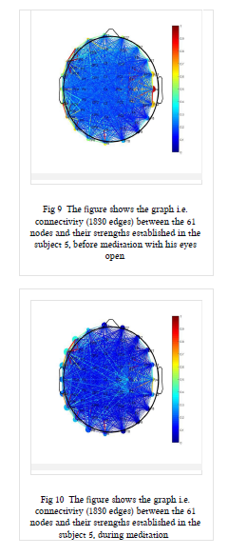
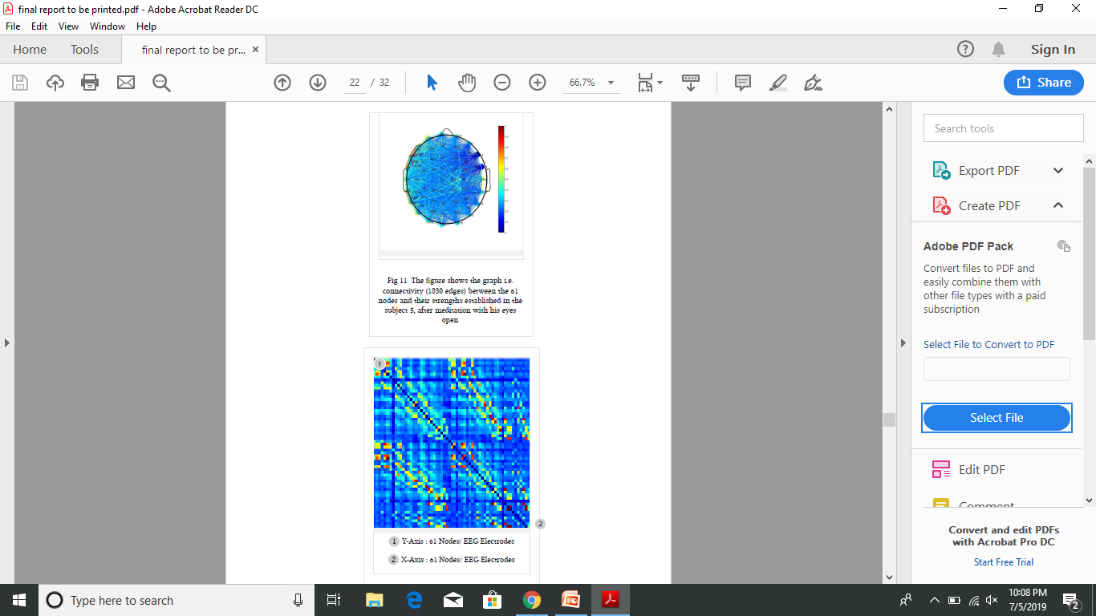
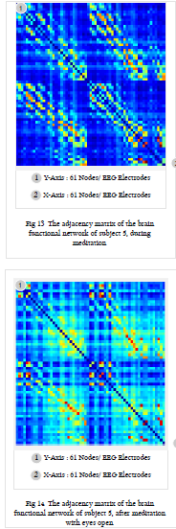
Brain Functional Network Visualization

Slide 9
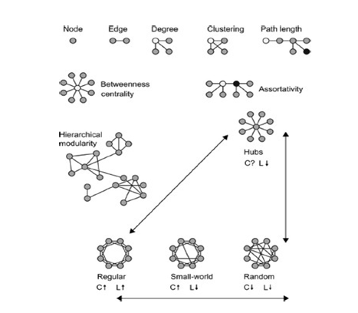
Network Metrics Analysis
Degree
Characteristic path length
Clustering Coefficient
Modularity
Betweenness Centrality - Node - Edge
Efficiency
Density

Slide 10
Different types of networks
1. Random Network
This kind of network consists of a set of nodes and the edges between them are totally random. If suppose the probability of an edge existing between a pair of vertices is ’p’, which will be same for all pair of vertices of the network. Therefore this type of network has low clustering coefficient and low average shortest path.
2. Regular Network
If starting with a set of nodes represented on a circular ring and each node is only connected to its nearest neighbours. So if the node has total k neighboring vertices then symmetrically it will have k/2 on each side of the node on the ring. In this type of network clustering coefficient is high and path length is also high.
3. Small World Network
If on the regular network with probability ‘p’ a few random connections are rewired. This would though keep the clustering coefficient high but the path length would reduce giving rise to a distinct small world topology comprising of both high clustering (compatible with segregated or modular processing) and short path length (compatible with distributed or integrated processing).

Slide 11
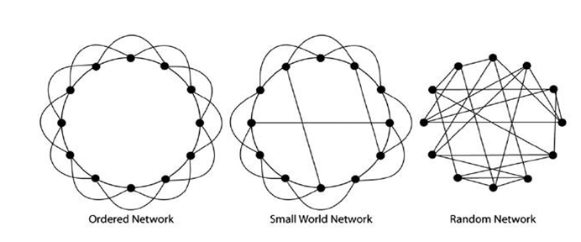
Different types of networks
Fig: The three different types of network models with different values of clustering coefficient and shortest path length value namely: Ordered/Regular Network, Small ordered Network and Random Network

Slide 12
Small World Network
A network with small-world property needs to meet two conditions:
i) Normalized Clustering Coefficient (ϒ) >> 1
ii) Normalized path length of the network (λ)~1 , where ‘rand’ stands for random graph
Thus, the small-worldness index (σ) comes > 1; the human brain functional network satisfies this criterion.
Thus, the brain supports both segregated and integrated information processing. Small-world topology comprises both high clustering (compatible with segregated processing) and short path length (compatible with integrated processing). Therefore, for a given brain network, if the brain network is found to have small-world property, it shows that the brain has better information processing performance.

Slide 13
Data Acquition
Data Preprocessing
Functional Connectivity Analysis
Brain Network Visualization
Network Metric Analysis

Slide 14
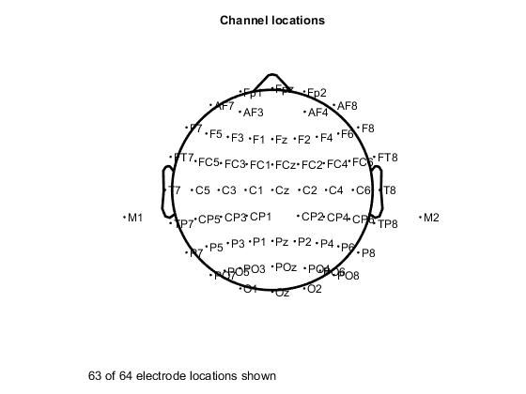
Data Acquition
EEG data was collected from experienced long- term meditators with average practice period ranging from 5-20 years.
EEG data were recorded with a high- density EEG system using a Waveguard^{R} EEG cap with 64 active electrodes.
The channel location (electrode locations) of the EEG system is as shown in the figure following the 10-20 system.
The data collected was divided into 3 major divisions namely: Before meditation during meditation, after meditation.

Slide 15
Preprocessing the EEG data
Types of artifacts :
Line noise (50 Hz- and higher harmonics)
Eye Artifact (Lateral Movement or Eye Blinks- EOG)
Muscle Artifact
Head Movement Artifact
Electrode Popping
DC removal ( ~0 Hz)

Slide 16
Preprocessing the EEG data
Removed the artifacts using the following measure:
Band pass Filter (0.05-45 Hz) – For required frequency band and removing DC Noise
Notch Filter (50 Hz,100Hz)- For removal of line noise
Run Independent Component Analysis and removal of components when identified with eye/muscle artifact
Automatic removal of bad channels and artifact effected data
Reject data manually – by setting a particular threshold and visual inspection

Slide 17
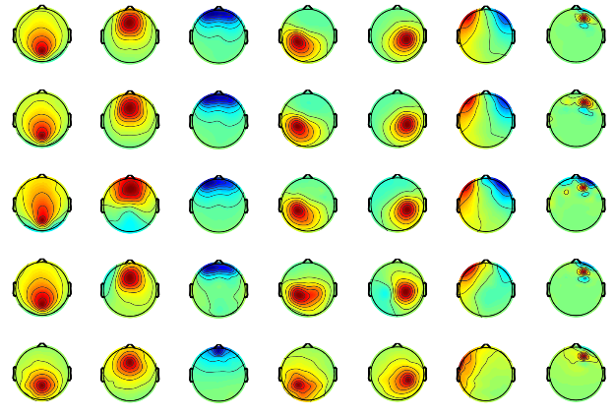
ARTIFACT IDENTIFICATION : ICA 1 2 3 4 5 6 7
Artifacts detected using the ICA run:
1 - Eye Lateral Movement
2 - Eye Lateral Movement
4 - Eye Blink 5 - Eye Blink
6 – Channel pop-up / Line Noise

Slide 18
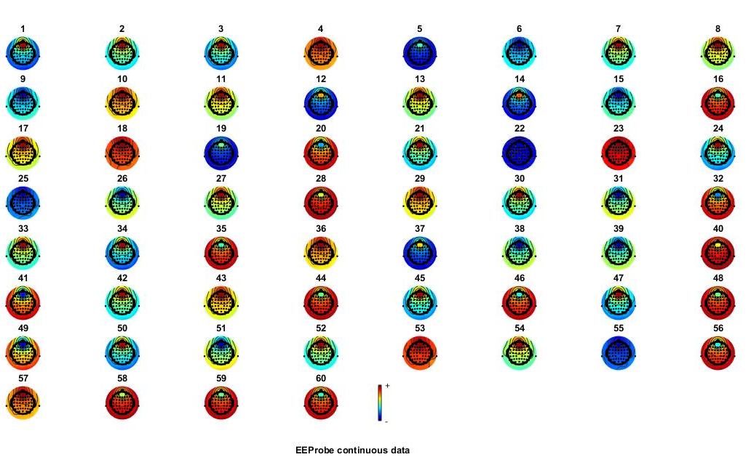
Preprocessing the EEG data

Slide 19
Functional Connectivity Analysis
Used EEGNET plug-in of MATLAB
This pipeline includes:
1) Loading and filtering the EEG signals
2) Computation of the functional connectivity
3) Calculation of the network measures
4) The visualization of 2D (scalp level) and 3D (cortex level) brain networks and associated measures.
The connectivity values can be computed over scalp signals (generating 2D networks) according to the method chosen in EEGNET.
Here, the Phase Locking Value (PLV) was computed between scalp electrodes as well as between sources as the connectivity measure.

Slide 20
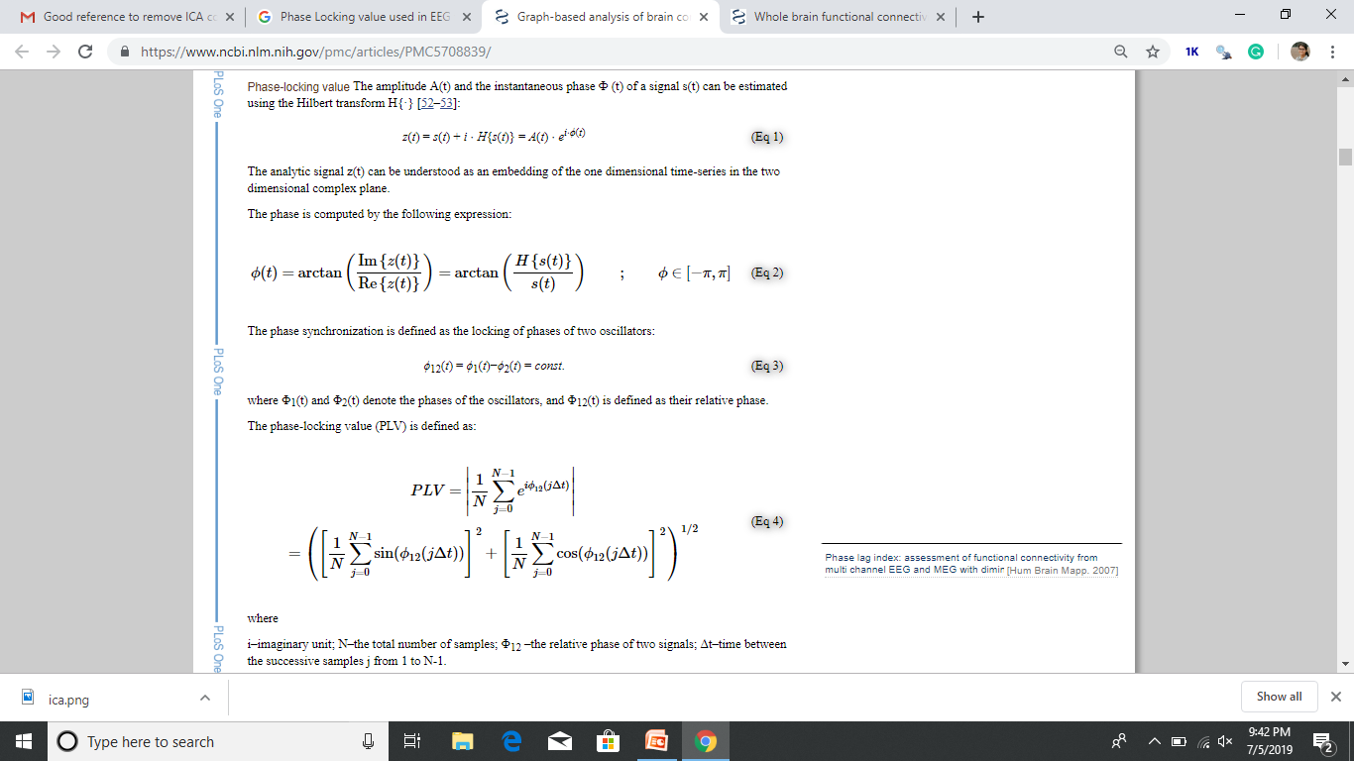
PLV

Slide 21

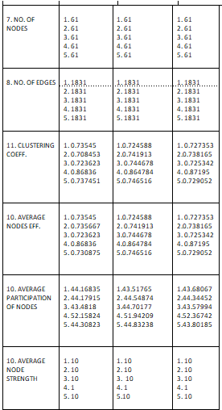
Network Metric Analysis

Slide 22
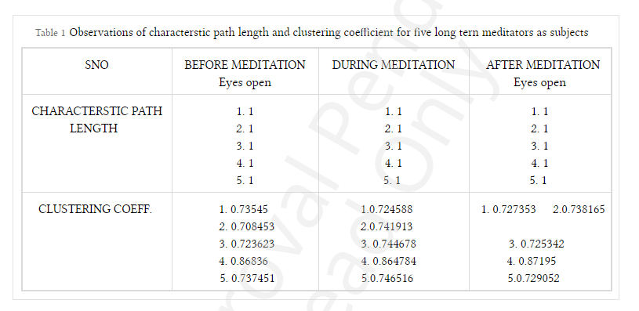
Observations

Slide 23
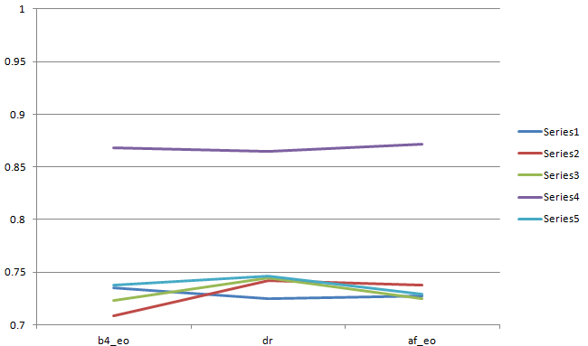

Slide 24
Observations of the clustering coefficients of the four meditating subjects (after elimination of the 4th subject)
Clustering Coefficient | Before Meditation | During Meditation | After Meditation
1 | 0.735 | 0.725 | 0.727
2 | 0.708 | 0.742 | 0.738
3 | 0.724 | 0.745 | 0.725
5 | 0.737 | 0.747 | 0.729

Slide 25
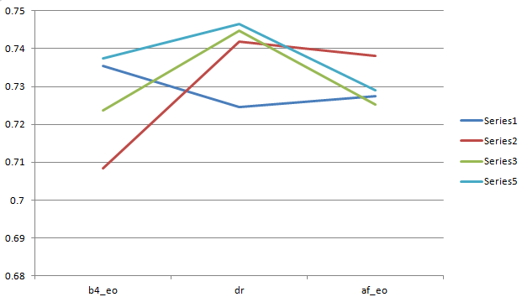

Slide 26


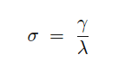
Calculations
Calculations of metrics for random graphs
Calculations of normalized values:
Calculations of the small worldness index

Slide 27
Observations
Calculated values of ratio of Clustering Coefficient of the experimentally observed graph and a corresponding random graph
Value of ratio of C and Crand | Before Meditation | During Meditation | After Meditation
1 | 45.6102 | 44.9365 | 45.1080
2 | 43.9359 | 46.0110 | 45.7785
3 | 44.8767 | 46.1824 | 44.9833
5 | 45.7343 | 46.2964 | 45.2134

Slide 28
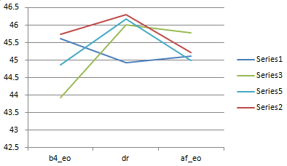
Normalized Clustering Coefficient :

Slide 29
Small Worldness Index Calculations
Calculated values of the small worldness index for the four subjects
Small Worldness Index | Before Meditation | During Meditation | After Meditation
1 | 45.6102 | 44.9365 | 45.1080
2 | 43.9359 | 46.0110 | 45.7785
3 | 44.8767 | 46.1824 | 44.9833
5 | 45.7343 | 46.2964 | 45.2134

Slide 30
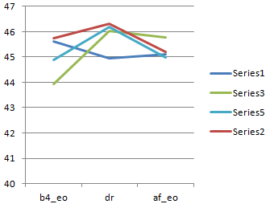
Plotting Small Worldness Index

Slide 31
Conclusions
The clustering coefficient increases in the before meditation phase till the meditating phase followed by decrease in the after meditation phase.
The clustering coefficient increased in brain networks due to meditation practice which means there is efficient parallel information transfer in the brain and that the different regions of brain being fired on together.
The ratio of the above two normalized quantities, i.e. the small worldness index is much larger than 1, which was the criterion to be satisfied to possess the small-world property.
The index is maximum at the time of meditation which signifies the perfect balance between the high segregation and integration property of the human brain i.e. following the small world topology.
We can conclude that meditation very evidently has an impact on the human brain functional network in terms of connectivity strength and level of integration.

Slide 32
Thank you !

